Slide 1
TYPES OF TITRATIONS
Name of the instructor: U.Nithya M.Sc.,M.Phil.,

Slide 2
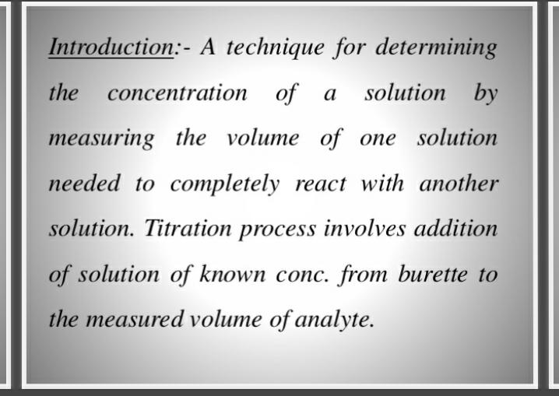

Slide 3
Titrametric calculation:
It is based on the following law of equivalence
v₁N₁= V₂N₂
(or) V₁M₁ = V₂M₂
Where. N₁ is the normality of analyte
v₁ is the volume of analyte
N₂is the normality of standard solution
V₂ is the volume of standard solution
M₁is the molarity of analyte
M₂is the molarity of standard solution.

Slide 4
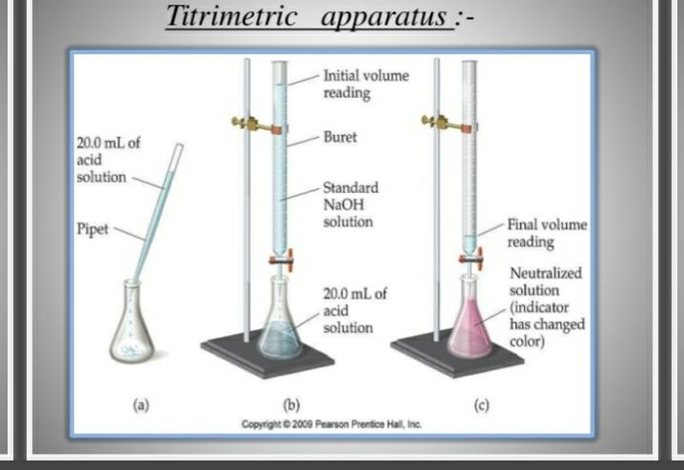

Slide 5
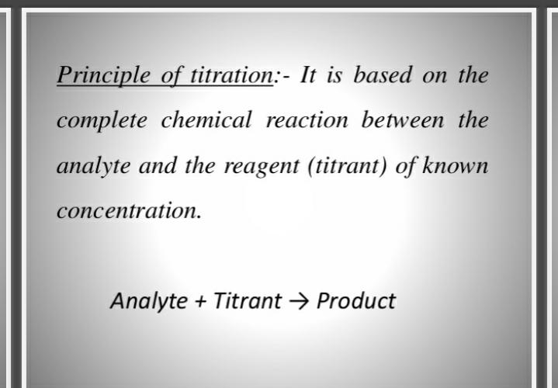

Slide 6
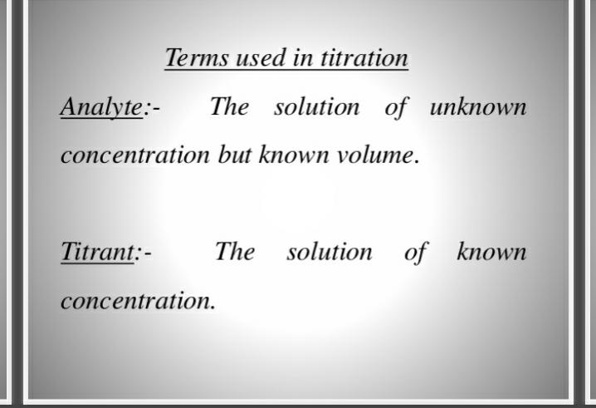

Slide 7
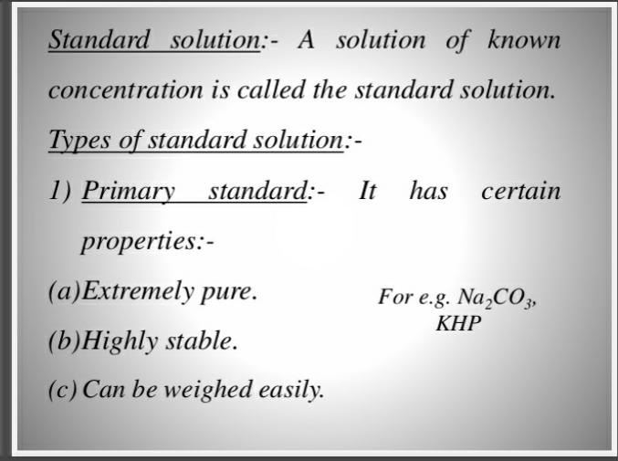

Slide 8


Slide 9
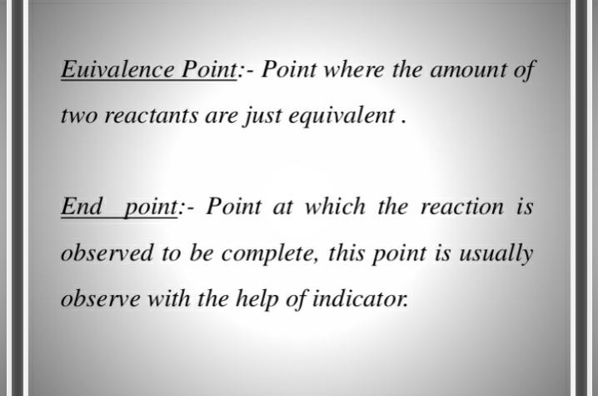

Slide 10
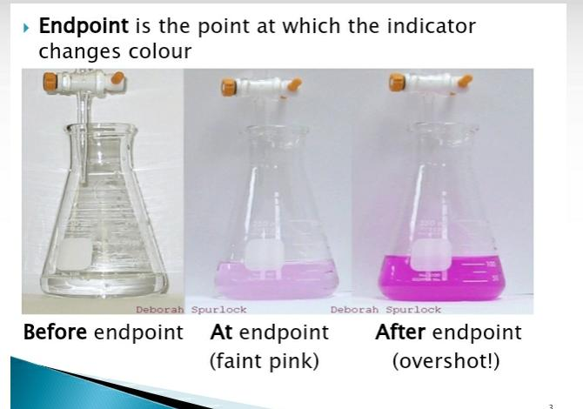

Slide 11
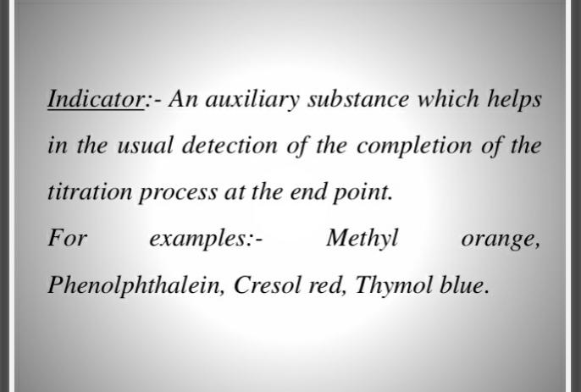

Slide 12
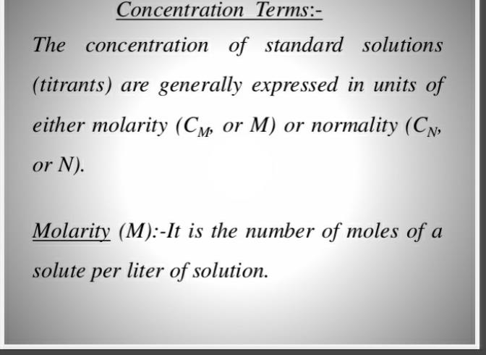

Slide 13
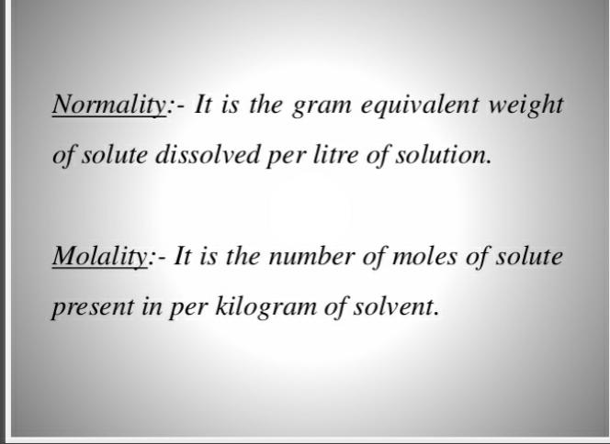

Slide 14
Basic requirements of a titrimetric reaction:
1. The reaction should be rapid.
2. The reaction should follow a stoichiometric equation. Then only we can calculate exactly the amount of the reacting substance.
3. The reaction must proceed to early 100% completion on addition of the stoichiometric amount of the standard solution.
4. The completion of the reaction as indicated by the end point should be easily determinable.
5. The reaction should not be reversible

Slide 15
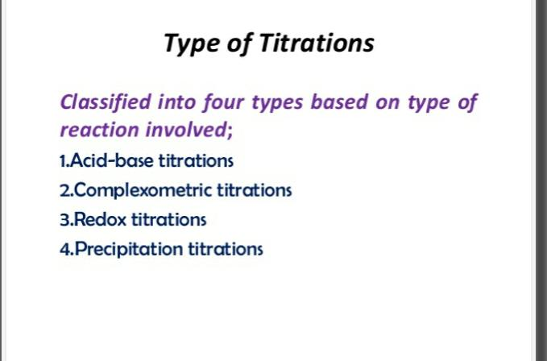

Slide 16
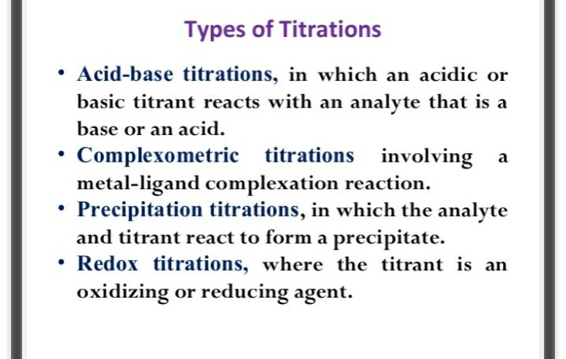

Slide 17
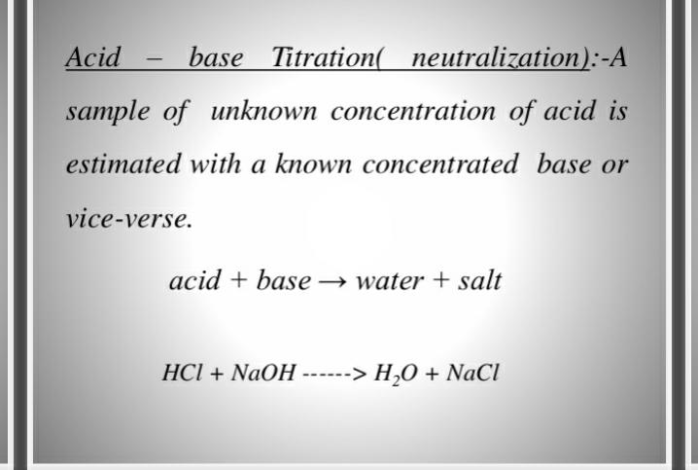

Slide 18
Principle:
The purose of titration of a solution of a base with a standard solution of an acid is to determine the volume of the standard acid required exactly to neutralise a given volume of base.
The point at which the acid neutralises the base completely is known as the equivalence point stiochiometric point or the end point.
At the end point an aqueous solutions of the corresponding salt is obtained.
In the titration between a strong acid and a strong base the resultant solution at the end point will be neutral and will have P^{H} 7.
In the titration between a strong base the resultant solution will be basic and its P^{h}will be more than 7.
Thus during a titration near the end point there will be a sudden change in the p^{H}of the soution undergoing titration.

Slide 19
This facts helps us to select an indicator which will change its colour with in the range of p^{H}change occurring during a titration.
we can measure the p^{H}of the solution undergoing titration after each addition of the titrant and plot p^{H}against the milli-litres of titrant added.
such a curve will have a sharp rise or fall in it which will indicate the end point.
Thus the end point in an acid-base titration is determined by using indicators or using a potentiometer.
A third method is to measure the conductivity of the solution that is undergoing titration and to draw a graph between the conductivity and the milli-litres of the titrant added.
The break in the graph indicates the end point.

Slide 20
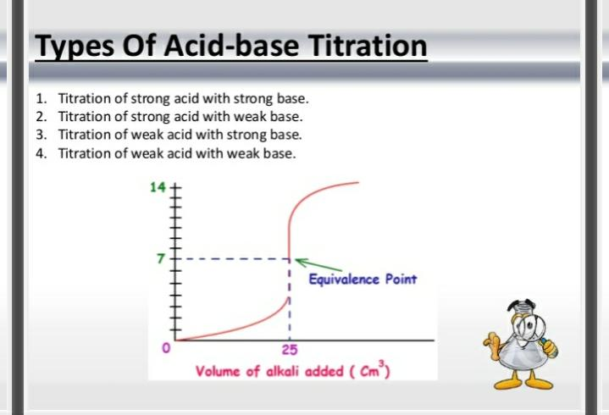

Slide 21
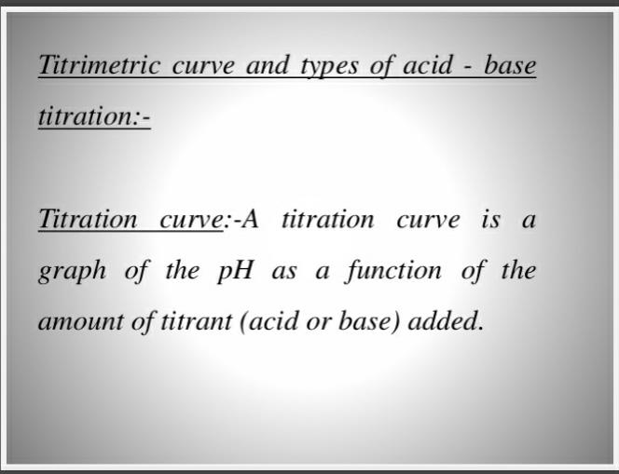

Slide 22
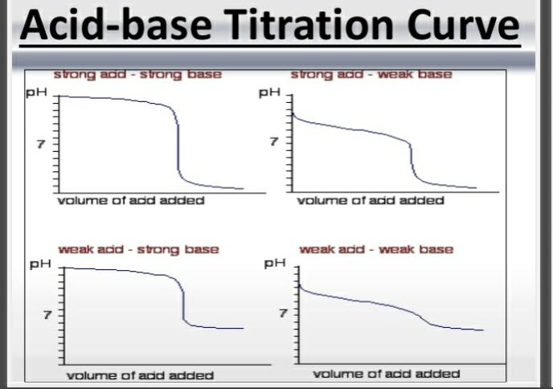

Slide 23
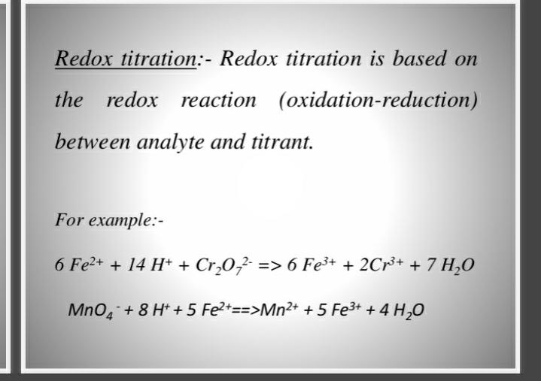

Slide 24
Eg: Titration between Feso₄ and ce(so₄)_{2.}
Fe²⁺ -----------------→ Fe³⁺ + e⁻
ce²⁺ + e⁻ -----------------→ ce³⁺
-----------------------------------------------------------------------------------------------------
Fe²⁺ + ce²⁺ ----------------→ Fe³⁺ + ce³⁺
Ferrous. Ceric. Ferric. Cerous
-------------------------------------------------------------------
end point is determined in two ways
1.The potential of the system changes abruptly in the neighbourhood of equivalence point.

Slide 25
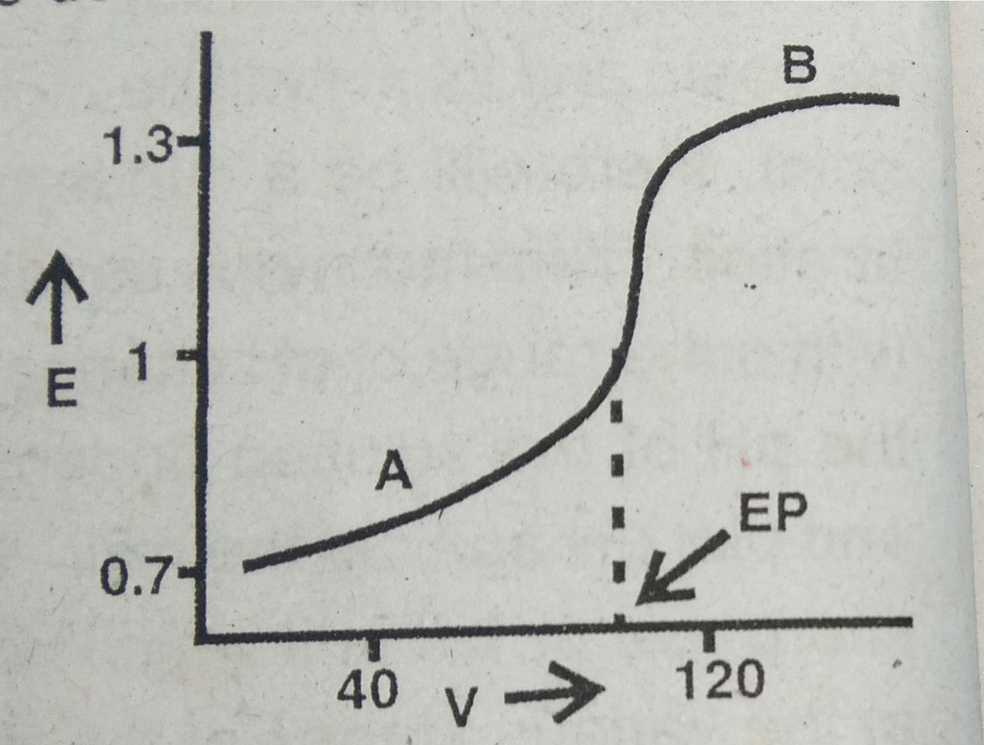
E = EMF in volts
V = volumetric of ceric solution in ml
EP = End point
A=Excess Fe²⁺
B = Excess ce⁴⁺

Slide 26
2. We can use indicators to determine the end point in redox titrations.
The indicators used to determine the end point in redoc titrations are called redox indicators.
Eg: i) diphenyl amine – Fe²⁺against K₂cr₂o₇.
ii) ferroin indicator – Fe²⁺against ce⁴⁺

Slide 27
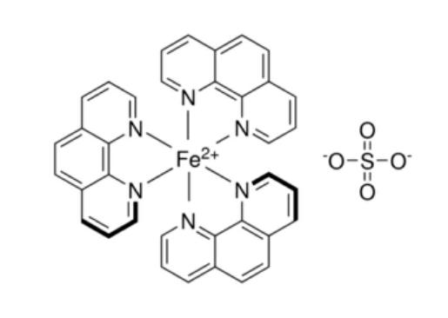
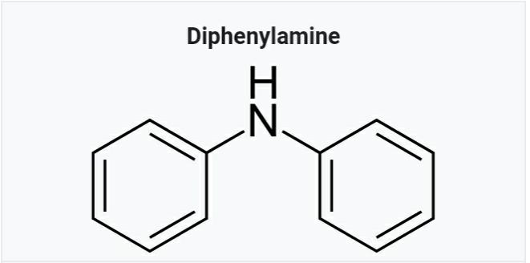
Fig. 1. Fig.2 (Ferroin)

Slide 28
THANK YOU

